Slide 1
Intro to Rhetoric & Argument Critique
Intro to Rhetoric Unit
How to identify (and attack) a weak argument
{Essays, Speeches, letters, articles, etc.}
*Link to the Quizlet set for vocab

Slide 2
Pre-Assessment
Answer in the front of your guided notes packet

Slide 3
Disclaimer*
*The opinions expressed in this unit’s videos, articles, or text readings are not necessarily my opinions or those of the school. :-)

Slide 4
Why are we doing this unit?
(Read unit overview)

Slide 5
CCSS OBJECTIVE:
“Delineate and evaluate the argument and specific claims in a text, assessing whether the reasoning is sound and the evidence is relevant and sufficient; recognize when irrelevant evidence is introduced.”
Thus, you need to be able to:
“Delineate” = outline it (or identify the different points)
“evaluate” = judge it
“argument and specific claims in a text” = the overall idea/thesis AND the big reasons why, in an article, essay, speech, etc.
“whether reasoning is sound” = is the argument makes sense, is logical, and/or is accurate
“evidence is relevant and sufficient” = is there enough of it? Is it on topic?
“recognize when irrelevant evidence is introduced” = notice when it is off-topic, inaccurate, or flawed

Slide 6
REVIEW: We may already know these words...
Argument: presenting a stance on an issue (but not trying too hard to persuade others to also take your stance)
Counter-argument: the opposite stance of an argument
Rebuttal: your “comeback” to someone’s argument or counter-argument
Refute (v) and Refutation (n): the act of rebutting a point

Slide 7
What counts as argument?
A majority of school & admissions essays
Some YouTube videos
Online reviews (& sometimes product feedback/ratings)
Anything that is presenting a clear stance on an issue
Certain documentaries & news shows
Debates
Most Speeches
Most Commercials
Certain sections of the newspaper: Editorials, Letters to the Editor, & Op-Eds
Magazine articles CAN be (some are informative)

Slide 8
NEW Terminology
Rhetoric: the art of using language effectively or persuasively
Rhetorical devices: techniques used to effectively communicate or enhance an argument
Ethos: an author’s credibility on the topic
Pathos: appeals to emotion, often through storytelling
Logos: appeals to logic or reason

Slide 9
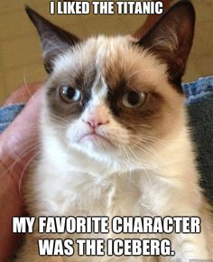
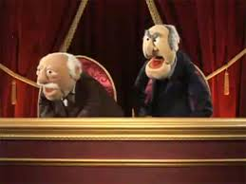
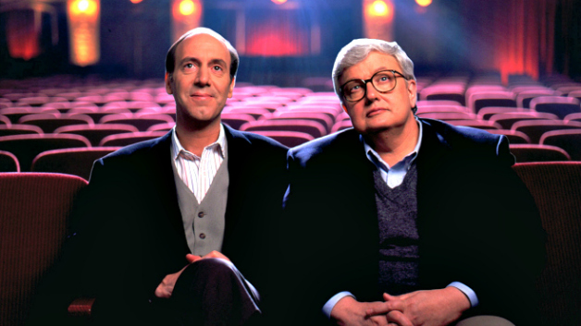
What does it mean to “critique”?
What do we know about critics?
Critique is not just for tv, movies, and books!
Can be...
Sarcastic, snarky, and witty
Cruel, harsh, and mean
Poorly-done, factually incorrect, and
Either subjective/opinionated or objective/unbiased

Slide 10
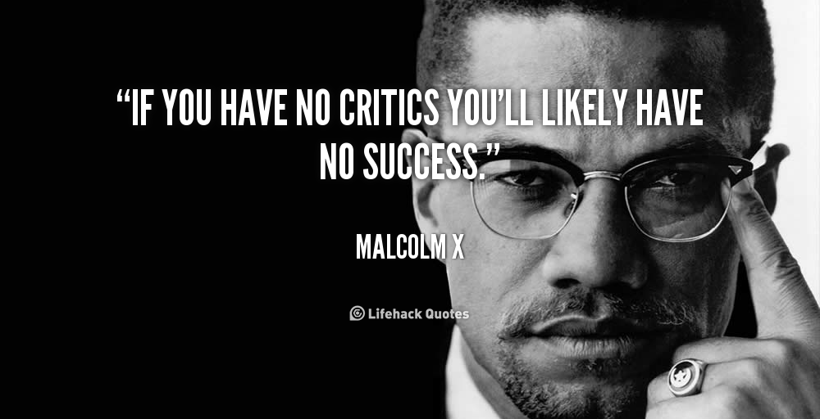
Make sure you are careful with these words & their (more extreme) synonyms...
Critique (v.): to appraise, evaluate, or judge
Attack (v.): to find fault with; point out real or perceived flaws
Counter (v.): to speak in response; indicating opposition or resistance
Refute (v.): to overthrow by evidence or proof; to prove to be false
Argument (n.): a developed, fully-explained stance on an issue
Persuasion (n.): defending an opinion with the goal of “winning”, using logical and emotional tactics.
Life Moment
Celebrities and “regular” people alike deal with criticism. It’s pretty much expected.
Sometimes criticism is healthy, valid, and helpful towards your personal growth. Other times, haters come from jealousy or bias.
YOU can control how you react to criticism in life. Take it with a grain of salt when needed!

Slide 11
Why do we care?
A written, online critique can “live” forever.
We need to filter what we say AND how we say it.
There’s a fine line between pointing out the flaws in something and being a bully.
Others will actually judge YOU if your critique is bad, even if your opinion is valid.
We are both the critic and the criticized every day.

Slide 12
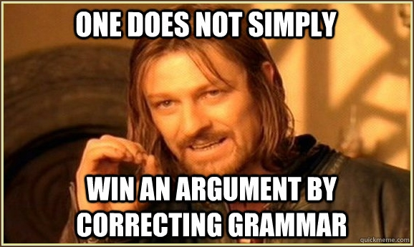
How it works
PAY ATTENTION to what is being said.
Take actual notes (ex: debate)
Annotate it (ex: article, essay, transcript)
Listen carefully (ex: speech or commercial)
2. NOTICE when a sentence/paragraph is problematic.
(We will talk about this more on the next slides.)
3. REFUTE or CRITIQUE that weakness tactfully, based on the situation.
How polite and formal should you be? (Do you need to filter your reaction?)
Is your critique going online and/or in print? (How many other people will read it?)
What are the rules or social norms of your situation?
Ex: Debate (Must formally address all weaknesses during your turn, or you could lose)

Slide 13
One last piece of wisdom
Do
Proofread and revise your drafts.
Choose reasons and supporting facts that ACTUALLY prove the point you’re making
Be confident without being arrogant, unfairly biased, or rude
Get someone else to read it first
Don’t
Say things just because you’re desperate to win
Become too lazy to do good research for your facts
“As a writer, how can I make sure that MY argument isn’t flawed?”

Slide 14
Review/Reflect
What’s the biggest or most important thing you’ve learned today?
When have you already seen one (or more) of these concepts in action in your life?
Why do you think this unit will be useful or important to you?

Slide 15
Now, turn to your FLIPBOOKS ☺
1. Review the Basics 2. Flaps 2-6: “Good” qualities of a speech/argument 3. Flaps 7&8: Negative qualities of a speech/argument 4. Review flap Next: Vocab POSTER Assignment & Quizlet Practice!

Slide 16
Q&A
Yes and No.
No, you don’t have to memorize all these terms and their names.
(Ex: “That’s a post hoc fallacy!”)
Yes, you need to be able to recognize them when they happen.
(Ex: “The author claims that smoking causes cancer, when in reality they are just correlated.”)
“Um, that was a lot of information. Do I have to memorize this?”

Slide 17
Practice #1:
Whole-Class Example
Read the following argument and try to notice all its flaws. We will be filling out our graphic organizer afterward.
Text: Sample Essay, “Why Schools Shouldn’t Take Away Summer Vacation”

Slide 18
Practice #2:
Critiquing opposing arguments
Discuss: How do we decide which one is “better”? We will be adding to our graphic organizer again after reading these.
Text: New York Times “Room for Debate”
Teens and Screen Time is a Problem, but More Study is Needed
Don’t Limit Your Teen’s Screen Time

Slide 19
Practice #3:
Individual Practice/Choice Assignment
Text: CHOICE :) Let’s look at the directions, rubric, and sample critique together!

