Slide 1
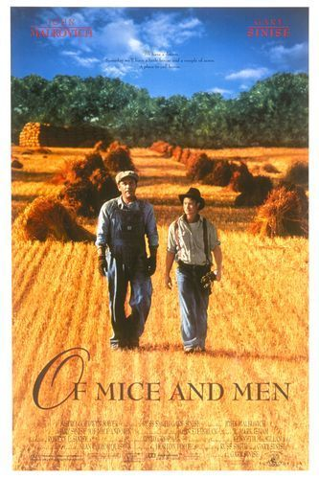
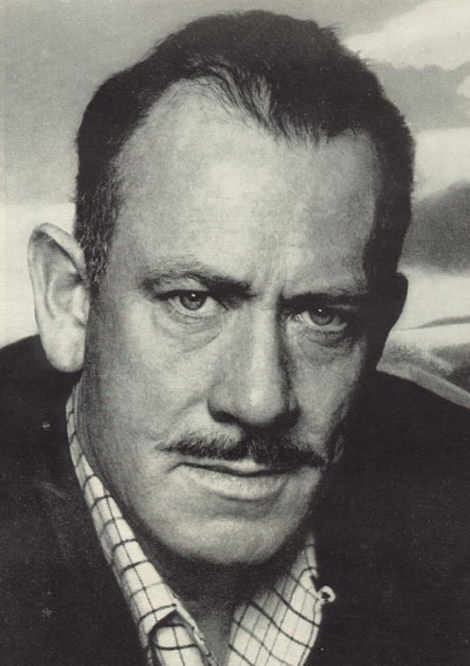
Introduction to
Of Mice and Men
By John Steinbeck

Slide 2
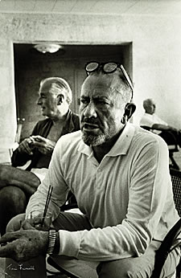
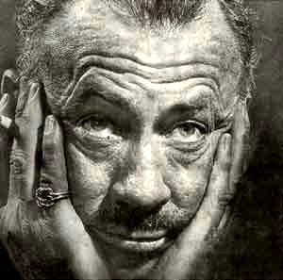
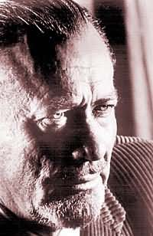
John Steinbeck
One of The Great American
Writers of the 20th Century

Slide 3
A Look at the Author
Born February 27th in 1902 in Salinas, California,
John was the third of four children, and the only son.
During his childhood, Steinbeck
learned to appreciate his surroundings,
and loved the Salinas countryside and
the nearby Pacific Ocean; it would be
this appreciation that would later come
out in his writing.
Steinbeck worked during his summers as a hired
hand in nearby ranches.

Slide 4
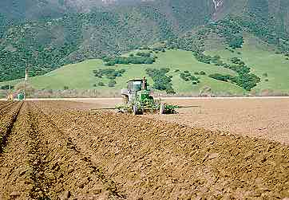
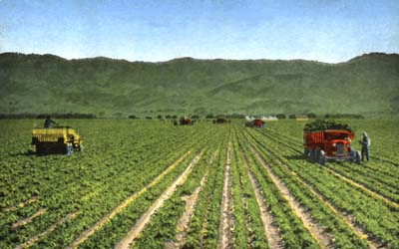
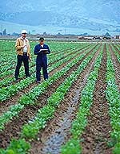
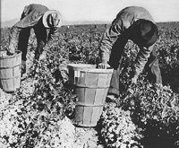
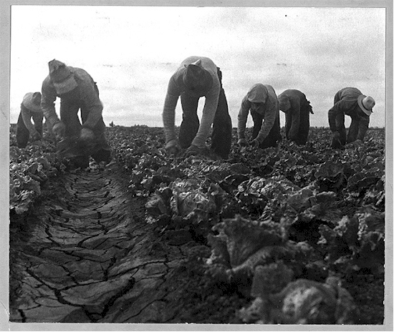
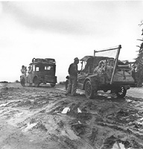
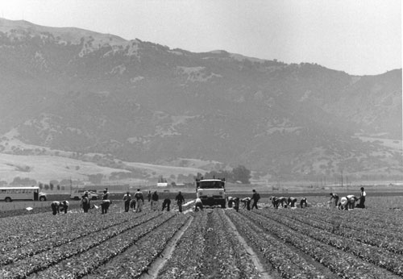
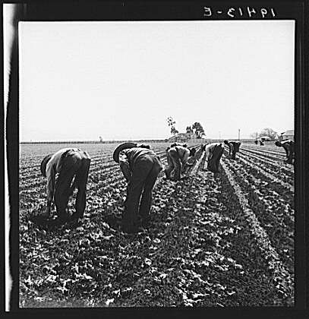
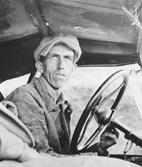
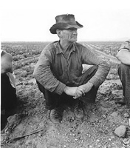
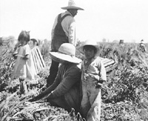
The Fields of Salinas, California

Slide 5
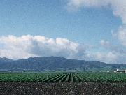
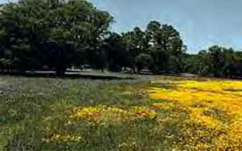
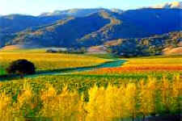
The Beauty of Salinas
Rich, fertile soil

Slide 6
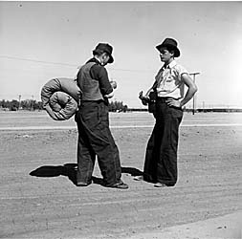
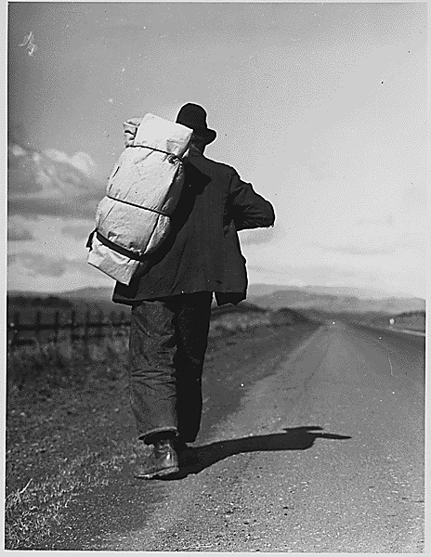
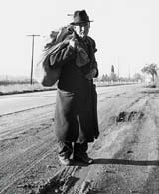
What’s a Bindlestiff?
A hobo, especially one who carries a bedroll.

Slide 7

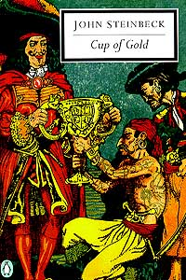




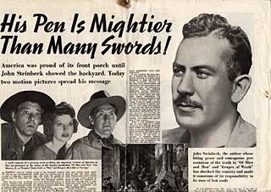
During the late 1920s and 1930s, he concentrated on writing and wrote several novels set in California.
Steinbeck gained
great success by
readers and critics.

Slide 8

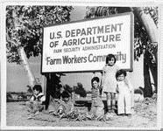
In 1939, The Grapes of Wrath
was published and became an
instant best-seller; in 1940 it was
awarded the Pulitzer Prize, one
of the most prestigious literary
awards in the world.
This novel, just like Of Mice and Men,
stemmed from his experience working
among migrant workers.
Steinbeck’s experiences in the fields
researching migrant workers led him to
have more compassion for these workers,
and stirred up his concern for social
justice.

Slide 9


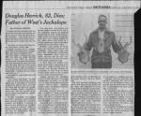
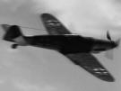

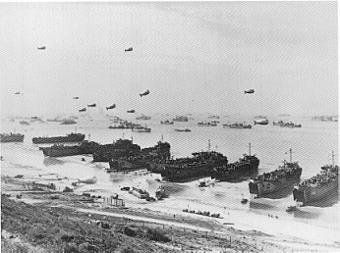
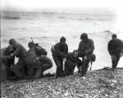
In 1943 he married Gwendolyn
Conger who would father him two
sons before their divorce in 1948.
In 1943 Steinbeck
worked as a war corre-
spondent for the New
York newspaper, Herald
Tribune.

Slide 10


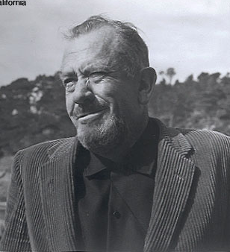
John Steinbeck died on December 20, 1968, at his apartment in New York City.
His wife took him home to Salinas to be buried near the land that he spent his life writing about.

Slide 11
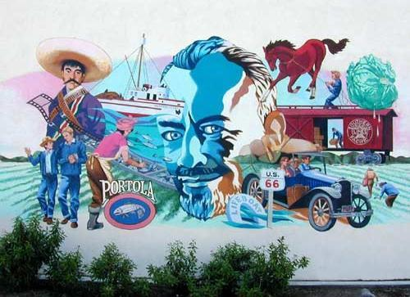
Mural overlooking The National Steinbeck Center in Salinas

Slide 12
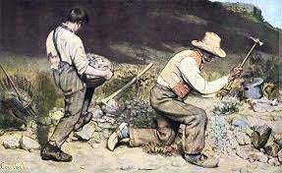
What is realism?
Broadly defined, a literary technique devoted to "the faithful representation of reality"

Slide 13
Realist writers …
Endeavored to accurately represent contemporary culture and people from all walks of life
Addressed themes of socioeconomic conflict by contrasting the living conditions of the poor with those of the upper classes in urban as well as rural societies
Sought to narrate their novels from an objective, unbiased perspective that simply and clearly represented the factual elements of the story
Became masters at psychological characterization, detailed descriptions of everyday life in realistic settings, and dialogue that captures the idioms of natural human speech

Slide 14
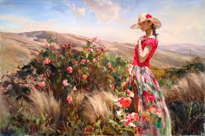
Local Color/Regional Literature
Local color or regional literature focuses on the characters, dialect, customs, topography, and other features particular to a specific region.

Slide 15
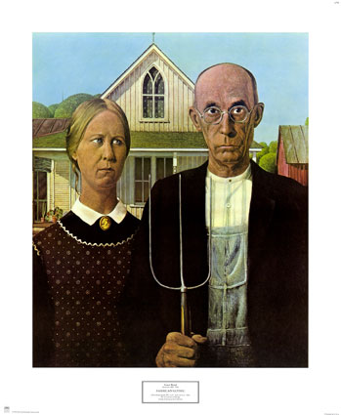
Shared Characteristics in Local Color & Regional Literature
Setting
Characters
Narrator
Plots
Themes

Slide 16
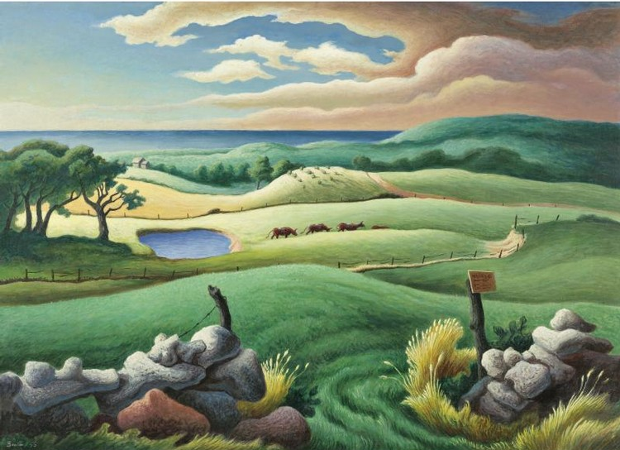
Setting
The emphasis is frequently on nature and the limitations it imposes; settings are frequently remote and inaccessible. The setting is integral to the story and may sometimes become a character in itself.

Slide 17
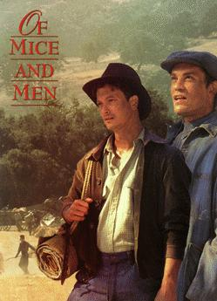

Slide 18

The Book
Of Mice and Men was originally called Something That Happened.
When Steinbeck first thought of the idea for the book he intended it to be for children. Steinbeck told a friend that he was experimenting with a new “dramatic form.”
In May 1936, he wrote a manuscript, but his puppy (a setter called Toby) ate it!
He said of the book:
  "It is an experiment and I don't know how successful."

Slide 19
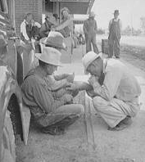
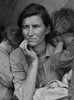
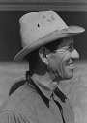
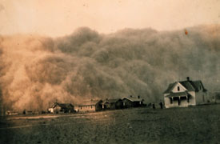
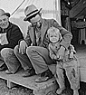
Of Mice and Men
The novel deals with the issues dear to Steinbeck’s heart - poverty, homelessness, the exploitation of itinerant workers, the failure of the Dream, America’s general moral decline.

Slide 20
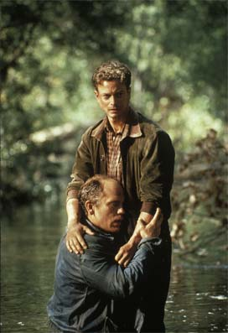
Main Characters: Lennie & George
George is described as physically small with very sharp features, an opposite to Lennie Small. Milton is the last name of the author of one of Steinbeck's favorite works, Paradise Lost. In that epic poem, Adam and Eve fall from grace in the Garden of Eden.
Lennie as a large, strong, lumbering, simple-minded man who is usually unaware of his actions and surroundings. His favorite thing to do is pet soft things. When we first meet him, he has a dead mouse in his pocket that he is petting with his thumb.

Slide 21
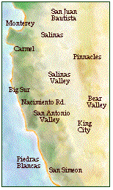
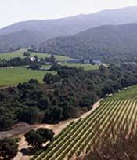
The setting in Of Mice and Men
The novel is set in the farmland of the Salinas valley, where John Steinbeck was born.
The ranch in the novel is near Soledad, which is south-east of Salinas on the Salinas river.
The countryside described at the beginning of the novel, and the ranch itself is based on Steinbeck’s own experiences.

Slide 22
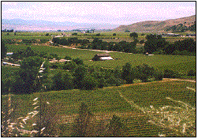
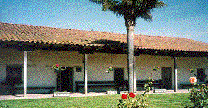
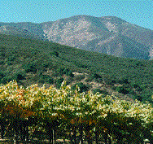
Soledad, California

Slide 23
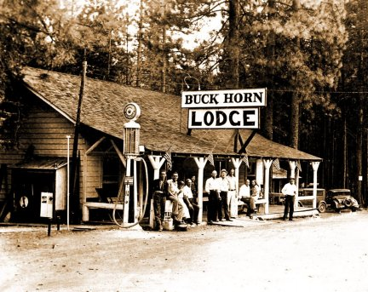
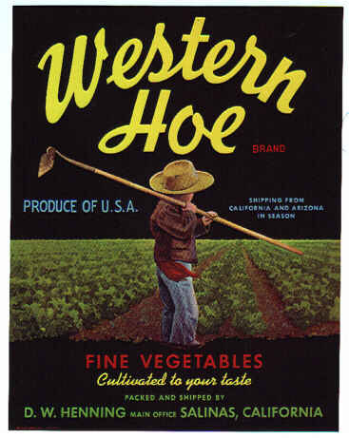
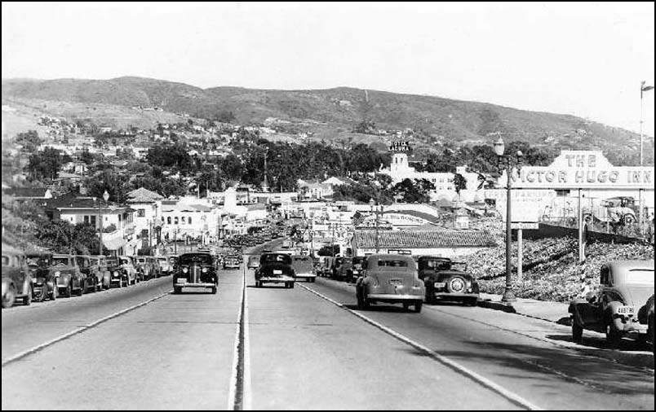
California in the 1930s

Slide 24





Why Migrant Workers?
Before technology created farm machinery, humans had to do a lot of the farm work by hand.
Between the 1880s and the 1930s, thousands of men would travel the countryside in search of work.
Such work included the harvesting of wheat and barley.

Slide 25



Migrant Workers
These workers would earn $2.50 or $3.00 a day, plus food and shelter.
During the 1930s, the unemployment rate was high in the U.S., and with so many men searching for work, agencies were set up to send farm workers to where they were needed.
In the novel, George and Lennie (the two main characters) were given work cards from Murray and Ready’s, which was one of the farm work agencies.

Slide 26

Chasing the American Dream
“Give me your tired, your poor, your huddled masses yearning to breathe free, the wretched refuse of your teeming shore.
Send these, the homeless, tempest tost to me,
I lift my lamp beside the golden door.”
( Emma Lazarus)
Written on the base of the Statue of Liberty

Slide 27


The American Dream
You can be successful if you work hard and live morally.
America is the land of opportunity.
Freedom to work hard and be happy is enshrined in the Constitution.
The Dream assumes equality of opportunity, no discrimination, freedom to follow goals and freedom from victimization.

Slide 28


The American Dream
From the 17th Century onwards, immigrants have dreamed of a better life in America.
Many people immigrated to America in search of a new life for themselves or their families.
Many others immigrated to escape persecution or poverty in their homeland.

Slide 29






Immigrants dreamed of making their fortunes in America.
For many this dream of riches became a nightmare.
  there were horrors of slavery,
  there were horrors of the American Civil War,
  there was a growing number of slums that were just as bad as those in Europe,
  there was also great corruption in the American political system which led to many shattered hopes.

Slide 30





The idea of an American Dream for many was broken when in 1929, the Wall Street crashed, marking the beginning of the Great Depression.
This era affected the whole world during the 1930s, but even in the midst of hardship, some people’s dreams survived.
Thousands of people made their way west towards California to escape from their farmlands in the Midwest that were failing due to drought.
The characters of George and Lennie dreamt of having a “little house and a couple of acres” which was their own dream.

Slide 31


Dreams
George and Lennie have a dream, even before they arrive at their new job on the ranch, to make enough money to live "off the fat of the land" and be their own bosses. Lennie will be permitted, then, to tend the rabbits.

Slide 32
Dreams
When George goes into a full description of the dream farm, its Eden-like qualities become even more apparent. All the food they want will be right there, with minimal effort. As Lennie says:
  "We could live offa the fatta the lan'."
When George talks about their farm, he twice describes it in terms of things he loved in childhood:
  "I could build a smoke house like the one gran'pa had..."
George yearns for his future to reflect the beauty of his childhood.
  "An' we'd keep a few pigeons to go flyin' around the win'mill like they done when I was a kid."

Slide 33
Meet the Other Characters
Candy
Curley
Curley’s Wife
Crooks
Slim
Carlson

Slide 34
Themes in Of Mice and Men
The Nature of Dreams
  In essence, Of Mice and Men is as much a story about the nature of human dreams and aspirations and the forces that work against them as it is the story of two men.
  Humans give meaning to their lives—and to their futures—by creating dreams. Without dreams and goals, life is an endless stream of days that have little connection or meaning.
  George and Lennie’s dream—to own a little farm of their own—is so central to Of Mice and Men that it appears in some form in five of the six chapters.
Loneliness
  In addition to dreams, humans crave contact with others to give life meaning. Loneliness is present throughout this novel.

Slide 35

Themes in Of Mice and Men
Powerlessness
  Steinbeck’s characters are often the underdogs, and he shows compassion toward them throughout the body of his writings. Powerlessness takes many forms—intellectual, financial, societal—and Steinbeck touches on them all.
Fate
  Life’s unpredictable nature is another subject that defines the human condition. Just when it appears that George and Lennie will get their farm, fate steps in.
My Brother’s Keeper
  Steinbeck makes the reader wonder whether mankind should go alone in the world or be responsible and helpful to others who are less fortunate.
Nature
  Steinbeck uses nature images to reinforce his themes and to set the mood.

Slide 36

Of Mice and Men – Title’s Origin
The title of the novel comes from a poem by the Scottish poet Robert Burns (1759 -96)
    The best laid schemes o’ mice and men
    Gang aft agley [often go wrong]
    And leave us nought but grief and pain
    For promised joy!
The best laid schemes of mice and men often go wrong- referring to a little mouse who had so carefully built her burrow in a field to protect herself and her little mice babies – and the burrow is turned over and destroyed by the man plowing.

